Slide 1






ECDS

Slide 2

Unmoderated or loosely moderated chat communities often suffer from:
ECDS
Off-topic discussions
Inappropriate or unethical content
Self-promotion and spam
Political, personal, or irrelevant conversations
Dilution of learning value These issues reduce learning effectiveness and community quality.
AI-based instant moderation system that evaluates chat messages before they are published and guides learners to stay within acceptable boundaries.

Slide 3
Impact :
ECDS
An In-stream AI moderator that evaluates every message in real time, blocks harmful content, and provides educational feedback to the sender. It evaluates content against dynamic boundaries using advanced LLMs, ensuring relevance and positivity. It educates senders with polite, constructive feedback to encourage better communication.
Create safer, distraction free learning spaces.
Promotes positive engagement.
Scales effortlessly across multiple groups.
Boosts trust and participation.

Slide 4


Unique Selling Propositions (USP):
ECDS
INNOVATIONS:
Instant AI-driven moderation that filters messages in real time.
Education feedback loop guiding users instead of just blocking.
Dynamic boundaries adapting to both generic and topic-specific rules.
Seamless integration with real-time chat using Socket.io for low latency
communication.
Real-time evaluations + constructive feedback for better communication.
Modern animated UI for a smooth, engaging user experience.
Scalable architecture ensuring low latency and easy expansion.
Learner-friendly design that fosters trust and positive engagement.

Slide 5
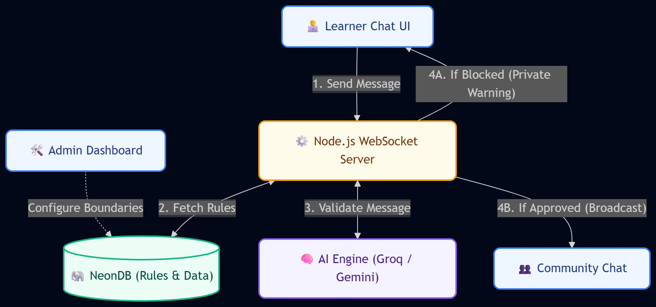
ECDS

Slide 6







ECDS
Frontend: HTML 5, Tailwind CSS, GSAP.
Backend: Node.JS, Express.JS.
Real Time Communication: Socket.io.
Database: Neon DB accessible via Neon MCP.
AI Engine: Groq API.

Slide 7
ECDS
Socket.io WebSocket events: Handles connection, message sending and broadcast logic.
AI Moderation Engine: Integrates Groq API with strict JSON response format.
Neon DB schema: Modular tables for users, groups, boundaries and
approved messages.
Modular Backend(Node JS + express): REST APIs for admin control and real time socket handling.
Fronted Integration: Vanilla JS + Tailwind CSS for responsive, animated user experience.

Slide 8
1.Anto Merary S
ECDS
Abdul Faiyaz S M
Abdul Arshath B
Dinesh S
Aswin Kumar K
Padmadev A

